Slide 1

Pakalo
Artificially Intelligent Cooking Assistant
Final Year Project Proposal
Abid Waqar i16-0229
Mashood Ur Rehman i16-0063 Supervisor
Nauraiz Mushtaq i16-0106 Dr. Omer Beg

Slide 2
The Problem
1.
What we aim to solve

Slide 3
What’s the problem?
New cooks have trouble following recipes
Trouble multitasking
Recipes do not account for the user’s own pace
Many new cooks do not know what they can make with what they have

Slide 4
The Target Demographic
Students
Amateur homecooks
New or aspiring cooks

Slide 5
44%

Slide 6
What is Pakalo?
2.
The Project Overview

Slide 7
A Chatbot
Conversational Chatbot
Step by step guidance along recipes
Speech input as well as just text
Helps the user by answering questions they may have

Slide 8
An Assistant
Recommends recipes the user may like
Recommends recipes based on a set of ingredients
Suggests substitute ingredients

Slide 9
A Social Platform
Users can add their own recipes
Users can rate recipes they have tried
They can leave comments
A thriving culinary community

Slide 10
High Level Features - A Summary
Recipe recommendations, based on history, preferences, and allergies
Step by step instructions along the recipe
Provide a list of ingredients for a recipe, and other information about a recipe
Recommend substitutes for ingredients
Relation between recipes and sub-recipes
Upload recipes using an image of a recipe
Ability to rate, comment, upload, and share recipes

Slide 11
Expected Outcomes
A smart, easy to talk to and use, intuitive chatbot that effectively guides the user along a recipe
Make the users feel comfortable cooking when using the app
To start a thriving social community

Slide 12
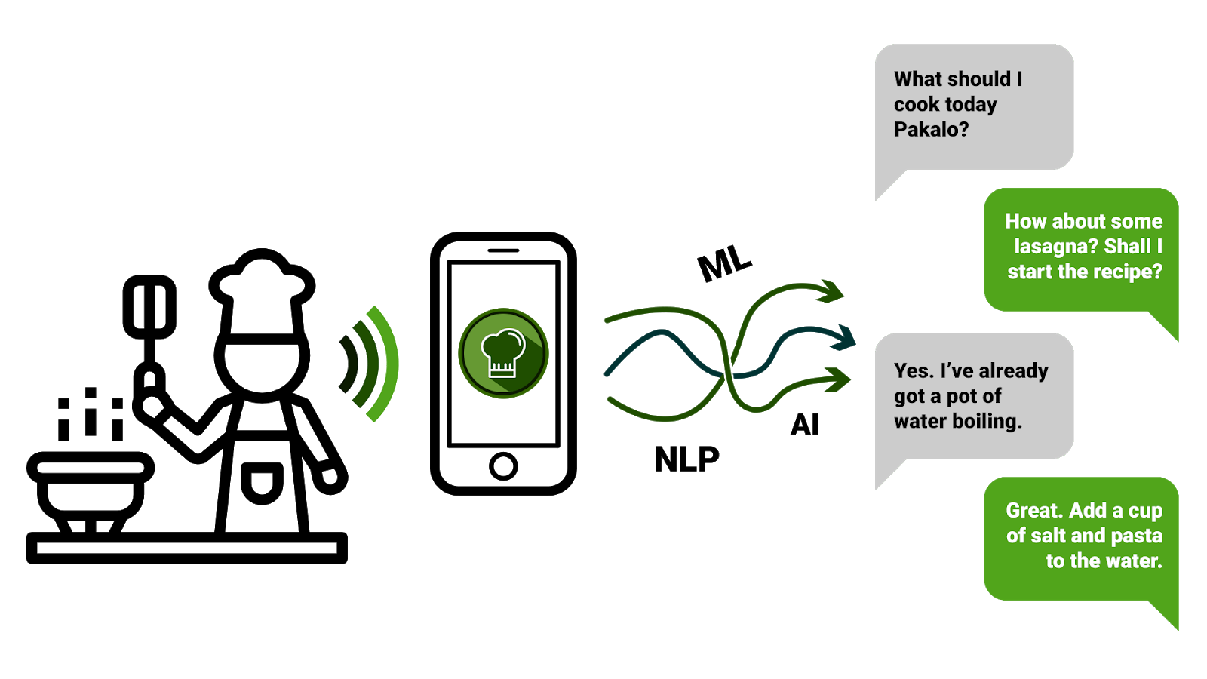
Flow

Slide 13

Example Scenario
Last time you loved the stir fry noodles. Would you like to try prawn noodles?
Okay. Start with putting a medium pot of water on boil
Yes that sounds good. Go ahead and start the recipe
Hey Pakalo, any idea what I should cook today?

Slide 14
The Development Process
3.

Slide 15
Our Timeline
Iteration
One
Iteration Two
Iteration Three
Iteration Four
Data Scraping
Preprocessing
Categorization
September
Model Formation
Model Training
Result Ranking
October, November
Dynamic Learning
Building Mobile Application
December, January, February
Recommendations
Efficient Responsiveness
Feedback
February, March, April

Slide 16
Technical Challenges
Using the history to accurately recommend recipes
Understanding user context
Understanding on which step of the recipe the User currently stands
Response Formation using RNN
Formation of the Knowledge graph

Slide 17






Tools and Technologies
Python
Android Studio
Keras
NLTK
Google Cloud Speech to Text

Slide 18
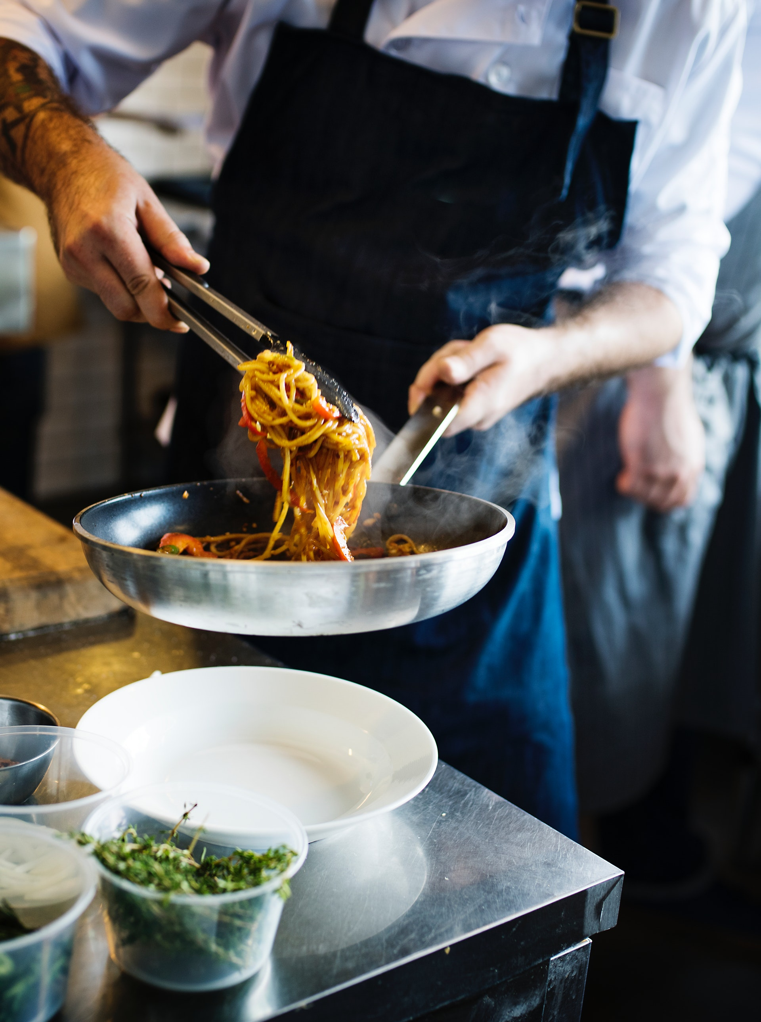
Thank you!
We would love to take any questions now.

Slide 19
References
S. Bird, E. Klein, and E. Loper, Natural Language Processing with Python: Analyzing Text with the Natural Language Toolkit. O’Reilly Media, Inc. 2009.
Daniel Jurafsky and James H. Martin, Speech and Language Processing, Pearson Education India, 2000.
Shawar, Bayan Abu, and Eric Atwell. Chatbots: are they really useful?. Ldv forum. Vol. 22. No. 1. 2007.
Swayam Mittal, Deep Learning Techniques for Text Classification, medium.com, August 17, 2019, [Online].

Slide 20
Expertise
Expertise | Mashood Ur Rehman | Abid Waqar | Nauraiz Mushtaq
Python | 8 | 8 | 8
Android | 1 | 2 | 3
NLTK | 0 | 0 | 1
Firebase | 1 | 0 | 0
Keras | 5 | 5 | 5
Data Mining | 8 | 9 | 8

